Slide 1


SCHOOL OF ENGNEERING & TECNOLOGY
SRI PADMAVATHI MAHILA VISWAVIDYALAYAM
(WOMEN’S UNIVESITY) TIRUPATI 517503, A.P, INDIA
A Project Abstract
On
ADAPTIVE NULLING OF MINOR LOBES IN ARRAY ANTENNA PATTERNS USING MATLAB
Under the guidance of:
K. Prasanthi,
M.Tech,(PhD) Assistant Professor
ECE Department
Presented By:
P. Lakshmi Jahnavi (2072057)
K. Meghana (2072071)
G. Pavithra (2072083)
K.G. Poornima (2072086)
T. Rekha (2072096)

Slide 2

ADAPTIVE NULLING OF MINOR LOBES IN ARRAY ANTENNA PATTERNS USING MATLAB

Slide 3
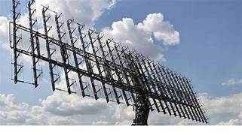
Abstract
MATLAB-based project focusing on nullifying minor lobes in array antenna patterns.
Objective: Enhancing antenna system's directional characteristics by suppressing undesired radiation.
Explored: Traditional beamforming, adaptive beamforming, convex optimization.
Key Findings: Successful reduction of minor lobe levels, improving antenna performance and offering practical insights for antenna design and deployment.

Slide 4
Introduction
In today's fast-paced world of communication technology, array antennas play a crucial role.
Array antennas, while powerful, often exhibit minor lobes—undesired radiation in secondary directions. These minor lobes can compromise the antenna's intended directional characteristics and impact overall system performance.
Our study is narrowly focused on implementing an innovative technique to nullify minor lobes. This technique promises to address a longstanding challenge in array antenna optimization.

Slide 5
Literature Review
Title: Coherent radar imaging using Capon's method
Author: Robert D. Palmer, Sridhar Gopalam, and Tian-You Yu
Journal: Department of Electrical Engineering and Center for Electro-Optics University of Nebraska, Lincoln

Slide 6
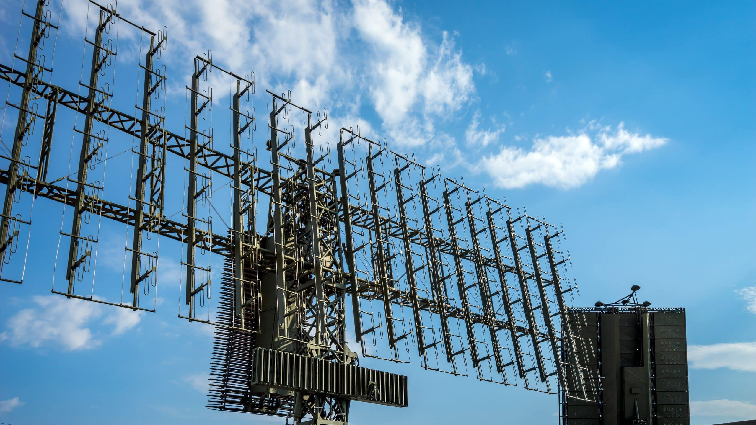
Array Antenna
Array antennas are a collection of individual antennas arranged in a specific pattern or configuration.
These antennas work together as a single unit to enhance the overall performance of the communication system.
The antennas are used to dynamically adjusts beam shape and direction, optimizing signal reception or transmission, overcoming interference, and improving system performance.

Slide 7
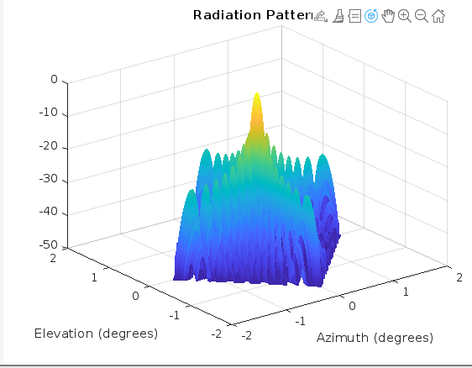
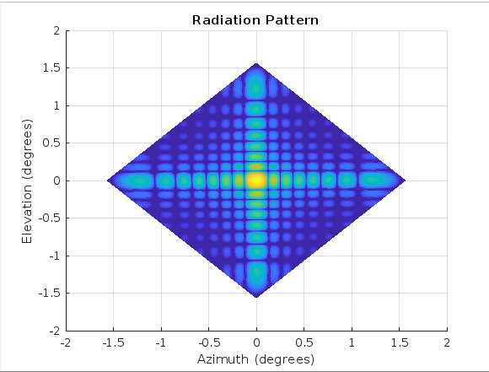
Radiation Pattern

Slide 8
Applications
Wireless Communications
Radar and Sonar Systems
Radio Astronomy
Electronic Warfare
Beamforming
Smart Antenna Systems

